Slide 1


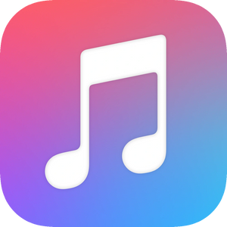
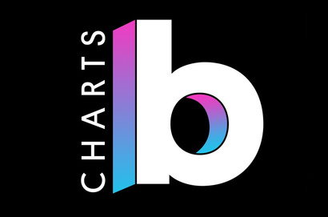

TikTok Trends & Top Songs
Emily Hurst
Gus Thanasuwandithee
Hanna Lakew
Mary Thissen
Victor Diaz
Project 2 | Group 4
Tik Tok has become a worldwide sensation and our group was interested in learning more about it's impact on the music industry. Our goal is to create a database that could be used to discover relationships between TikTok trends and top music charts.
Next

Slide 2
TikTok Trending Music Tracks
TikTok Trending Video: Apple/Spotify
Source: Kaggle
Data Type: CSV
This data set provides information on TikTok trending music tracks
Source: Kaggle
Data Type: CSV
This data set provides information on data from Apple and Spotify about the music that is used in trending TikTok videos
EXTRACT
DATA UTILIZED
Billboard "The Hot 100" Songs
TikTok Trending Videos
Source: Kaggle
Data Type: CSV
This data set provides information on Billboards "Hot 100" which is based on sales, airplay, and streaming
Source: Kaggle
Data Type: CSV
This data set provides information on top trending TikTok videos and the music used in them. It includes information such as danceability and liveliness of the music used
Next

Slide 3
Artist Name
TRANSFORM
Song Title - Album - Release Date
Explicit Content
All data was extracted and transformed using Python and Jupyter Notebooks. Multiple duplicate or unnecessary columns were dropped and one final data frame was created with columns that could allow TikTok's trending audio and video data to be compared with top music on the Billboard Music Charts.
TikTok Popularity - Spotify Popularity
Danceability - Liveliness - Energy - Loudness - Valence - Tempo - Mode - Speechiness - Acousticness - Instrumentalness
Billboard Chart Peak Ranking
Next

Slide 4
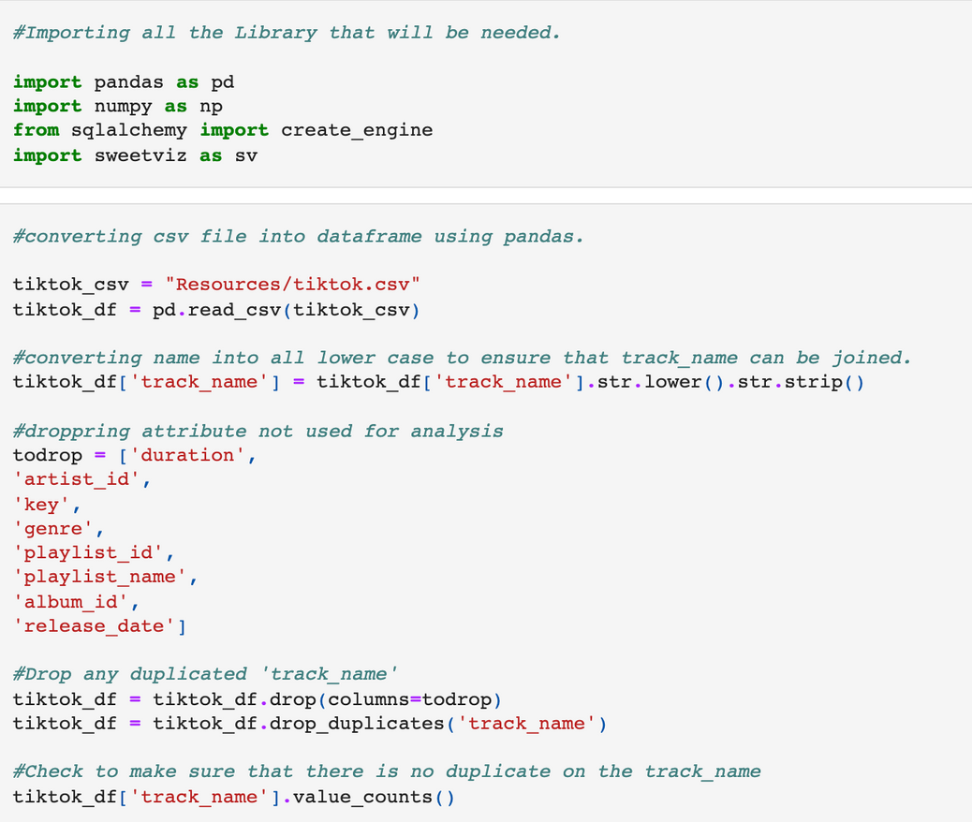
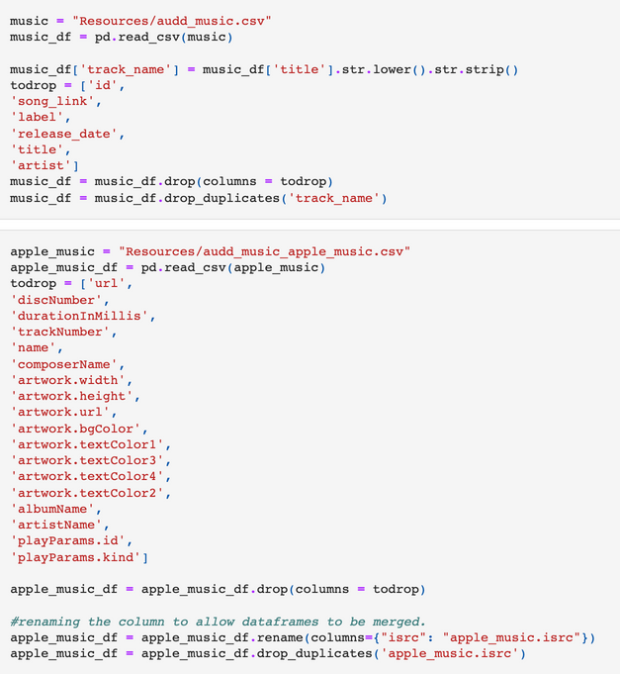
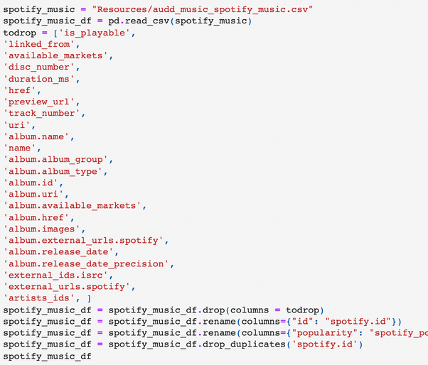
Transform TikTok Music Trends Data
We created individual data frames to clean and organize the information provided for TikTok's trending music, trending videos, and the Apple/Spotify data provided for those songs
Next

Slide 5
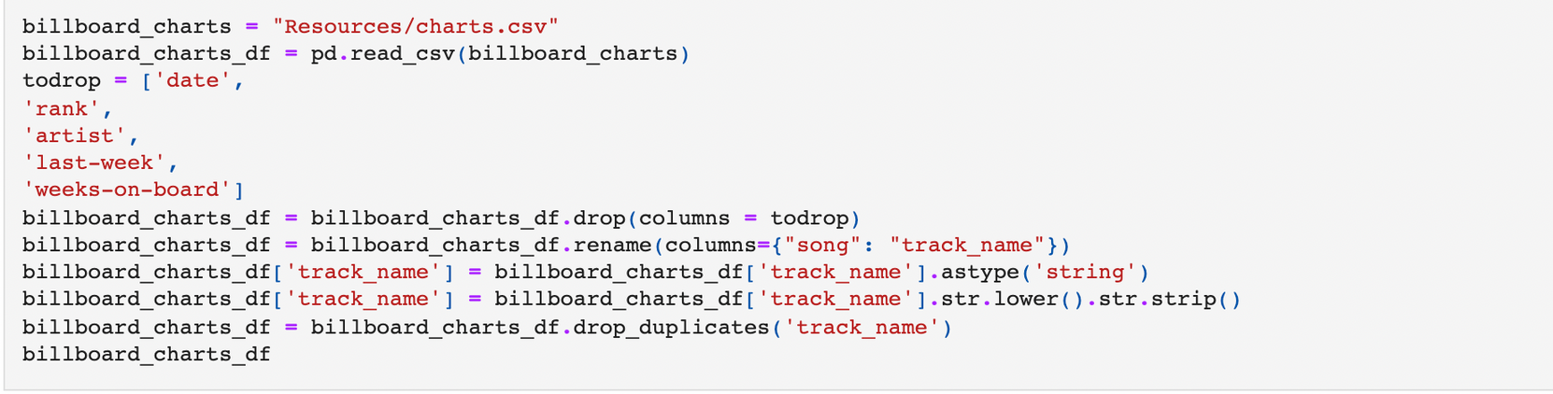
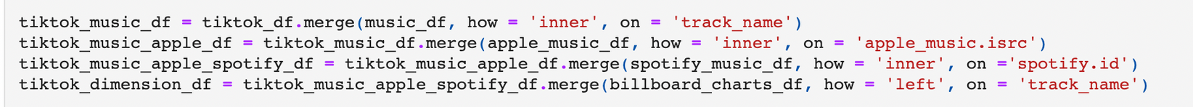
Transform Billboard Data
Transform Final Merge
Next

Slide 6
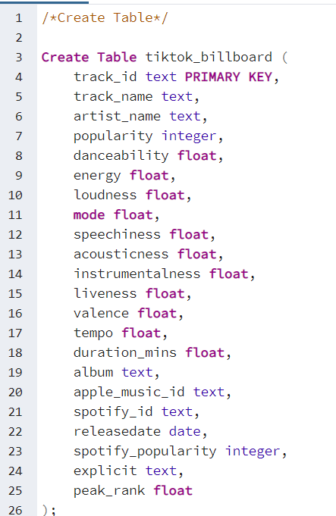
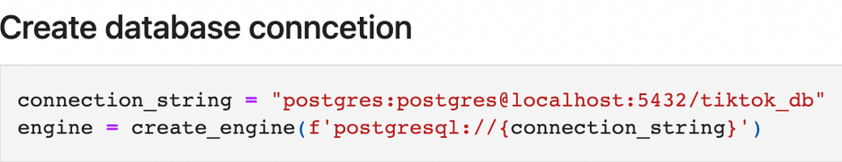
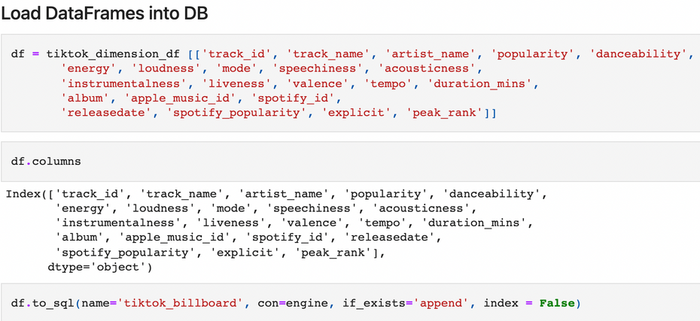
LOADING DATA
All data was uploaded in SQL using a final merged table which was created from the five data frames which displayed:
1. TikTok Trending Music Data
2. TikTok Trending Video Data
3. Apple Music Data
4. Spotify Music Data
5. Billboard Music Data
Next

Slide 7



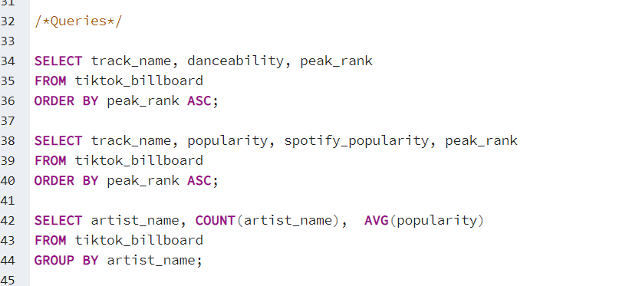
NEXT STEPS
POSSIBLE QUERIES
Next steps would be to utilize this database to make analysis into the types of music/videos that trend on TikTok and their relationship to top trending songs.
Possible queries include:
TikTok danceability vs Billboard rankings
Popularity on TikTok and Spotify vs Billboard Ranking
Artist popularity on Tiktok and their appearance on Billboard Charts

